Slide 1

DEPARTMENT OF PHYSICS
SRM INSTITUTE OF SCIENCE AND TECHNOLOGY
18PYB103J –Semiconduuctor Physics
Joint density of states
(Conservation of energy and momenta of electron
with photon interacts)
18PYB101J Module-IV Lecture-7

Slide 2
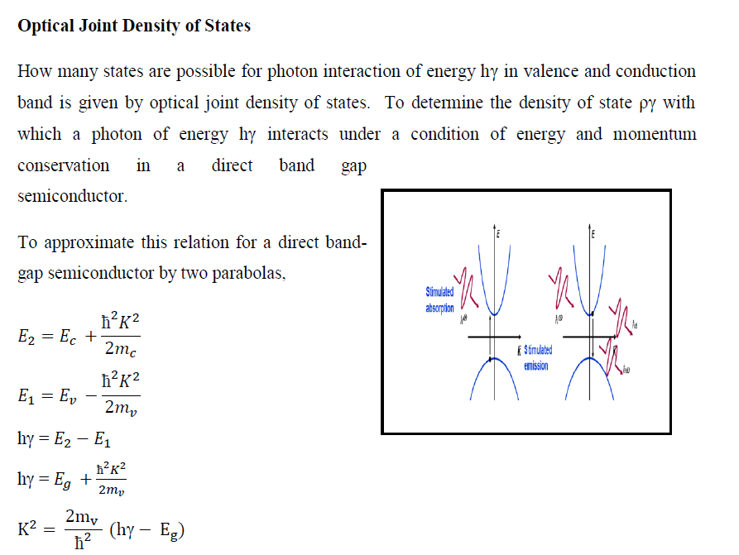
18PYB101J Module-IV Lecture-7

Slide 3
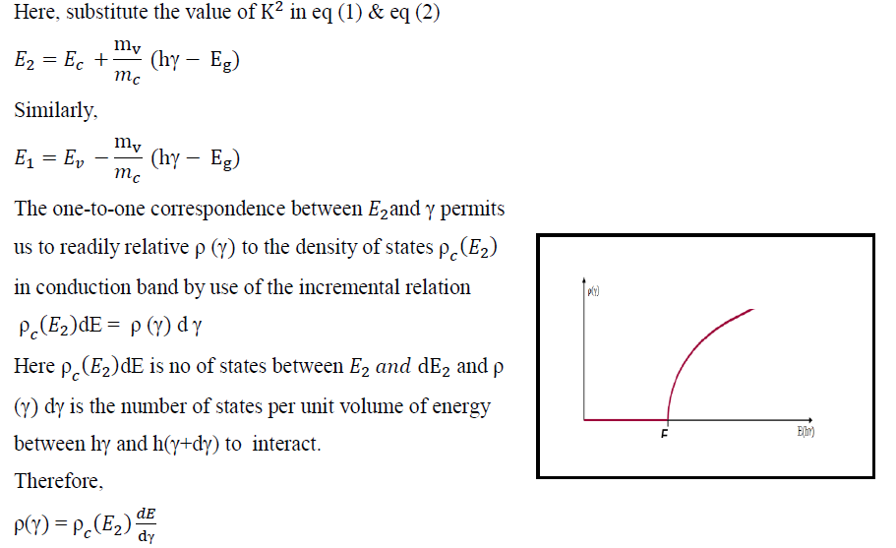
18PYB101J Module-IV Lecture-7

Slide 4
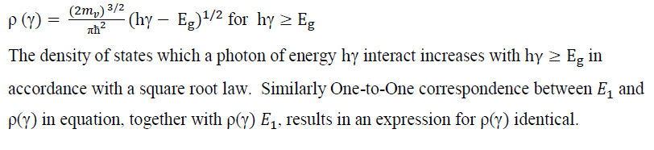
18PYB101J Module-IV Lecture-7

Slide 5
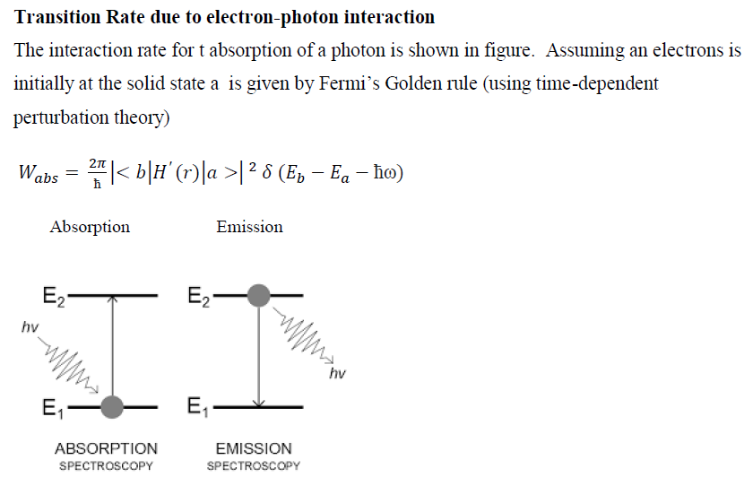
Transition Rate due to electron-photon interaction
18PYB101J Module-IV Lecture-7

Slide 6
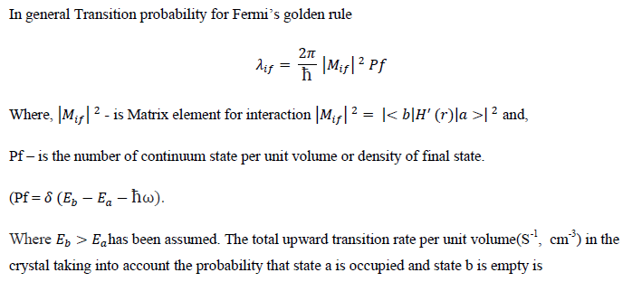
Transition Rate due to electron-photon interaction
18PYB101J Module-IV Lecture-7

Slide 7
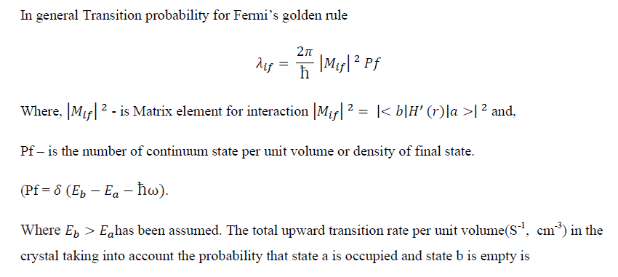
Transition Rate due to electron-photon interaction
18PYB101J Module-IV Lecture-7

Slide 8
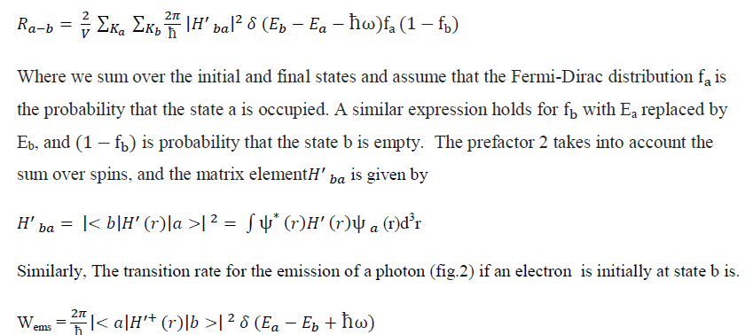
Transition Rate due to electron-photon interaction
18PYB101J Module-IV Lecture-7

Slide 9
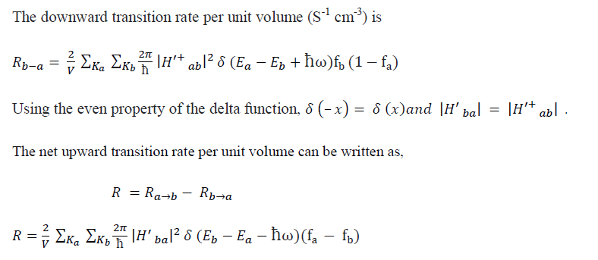
Transition Rate due to electron-photon interaction
18PYB101J Module-IV Lecture-7

Slide 10
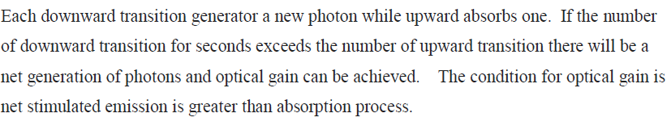
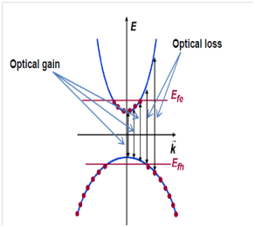
Optical Gain in Semiconductor
18PYB101J Module-IV Lecture-7

Slide 11
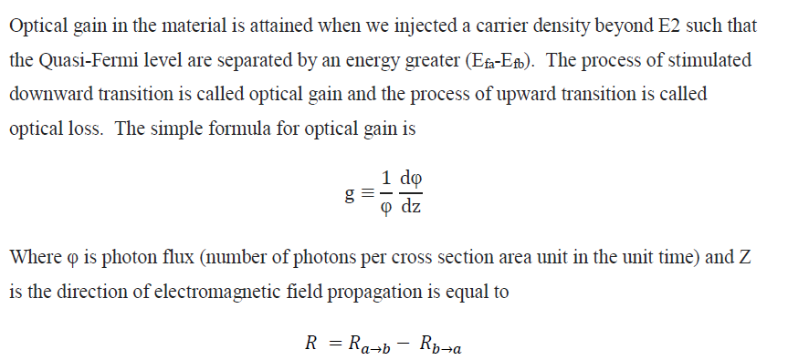
Optical Gain in Semiconductor
18PYB101J Module-IV Lecture-7

Slide 12
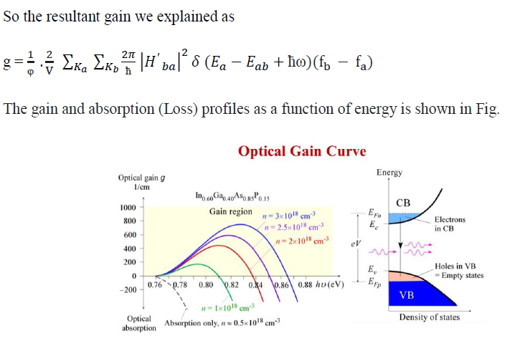
Optical Gain in Semiconductor
18PYB101J Module-IV Lecture-7

Slide 13
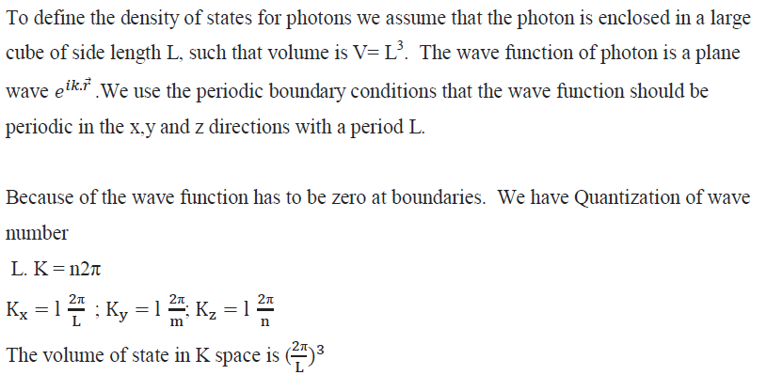
Density of States for Photons
18PYB101J Module-IV Lecture-7

Slide 14
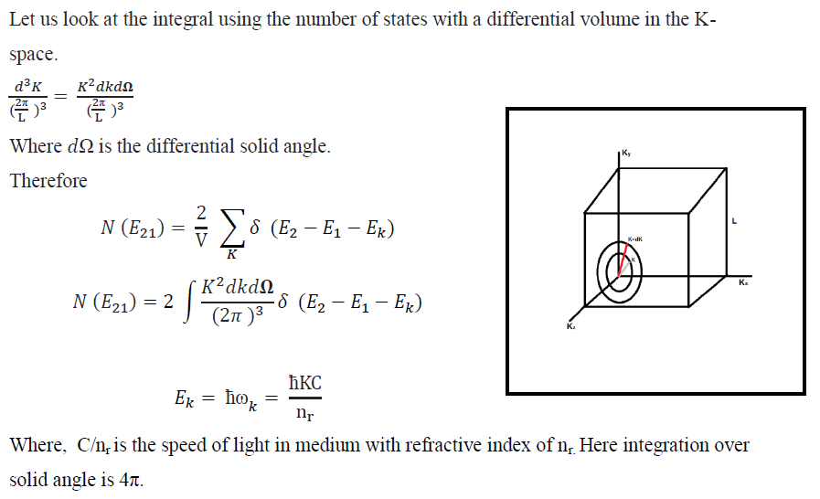
Density of States for Photons
18PYB101J Module-IV Lecture-7

Slide 15
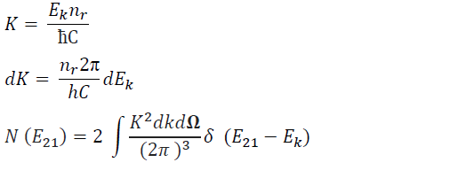
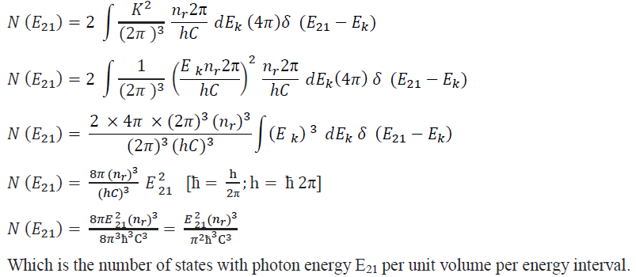
Density of States for Photons
18PYB101J Module-IV Lecture-7

Slide 16
Thank you
18PYB101J Module-IV Lecture-8

